Slide 1
Customer retention case study Presentation Lalbiak Zauva

Slide 2
Project analysis slide 2
Project Analysis
EDA and visualizations
Problem statement
PROJECT
Steps and assumptions
Analysis
How to improve
Conclusion

Slide 3
Problem statement
Customer satisfaction has emerged as one of the most important factors that guarantee the success of online store; it has been posited as a key stimulant of purchase, repurchase intentions and customer loyalty.
A comprehensive review of the literature, theories and models have been carried out to propose the models for customer activation and customer retention.
Five major factors that contributed to the success of an e-commerce store have been identified as: service quality, system quality, information quality, trust and net benefit.
The research furthermore investigated the factors that influence the online customers repeat purchase intention. The combination of both utilitarian value and hedonistic values are needed to affect the repeat purchase intention (loyalty) positively.
Results indicate the e-retail success factors, which are very much critical for customer satisfaction.

Slide 4
Assumptions
Some features of the dataset represents the same output and hence not all the features are visualized and analyzed.
Only those features which can uniquely represent the outcome are considered, analyzed and visualized accordingly.
Pie chart is used to visualize how important is the feature

Slide 5
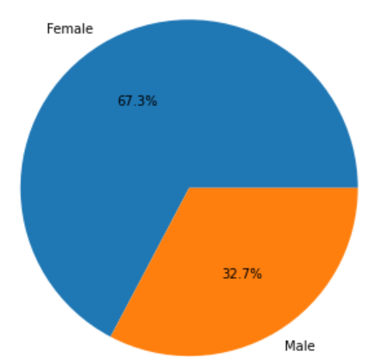
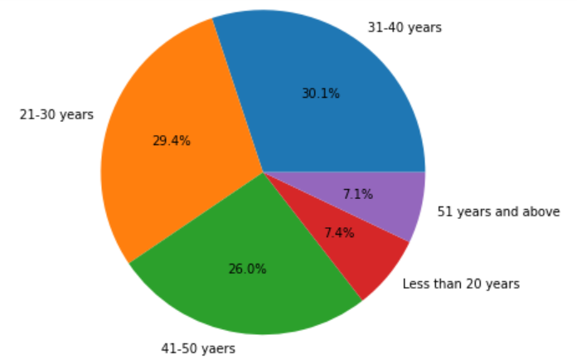
EDA and Visualizations
a
Personal information
a) Gender:
Around 2/3rd of the customers are female customers.
b) Age:
Most of the customers fall in the age group of 20 to 50 years.
We can see that this age group contributes more than 85% of the total customers.
b

Slide 6
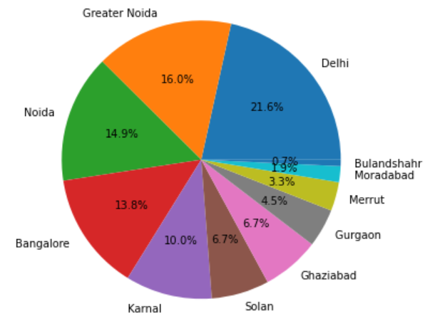
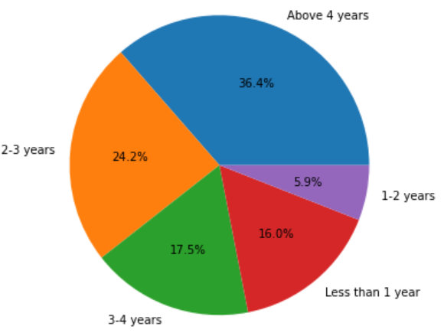
EDA and Visualizations
c
c) City
Delhi shows the highest number of customers followed by Greater Noida, Noida and Bangalore.
2. Customer activities while shopping online
a) Duration of online shopping:
1/3rd of the total customers have been using online shopping for more than 4 years.
About 40% of them have been shopping online for 2 to 4 years.
2.a

Slide 7
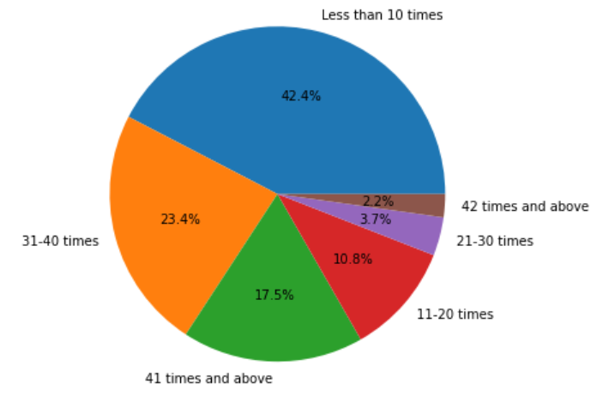
EDA and Visualizations
b) Number of purchases made in the past year:
Only 2.2% of them have made online purchase of more than 42 times.
Almost half of the customers have made purchase less than 10 times.

Slide 8
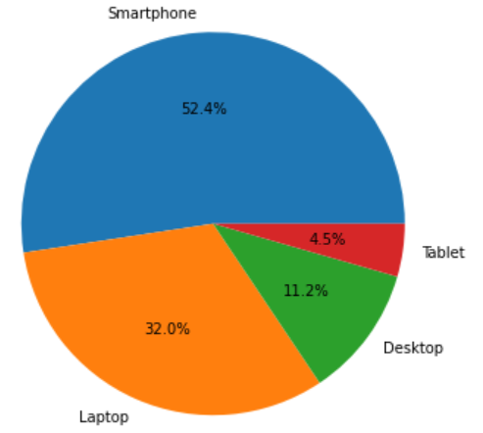
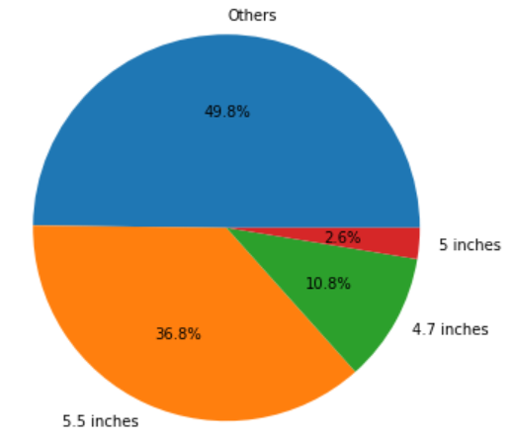
EDA and Visualizations
a
3. How customers reach online shopping platforms
a) Device used:
About half of the customers use smartphones.
1/3rd of them use laptop
b) Screen size
1/3rd of the customers uses a screen size of 5.5inch which is a typical size for any smartphone.
b

Slide 9
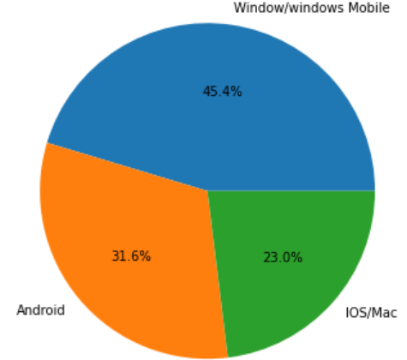
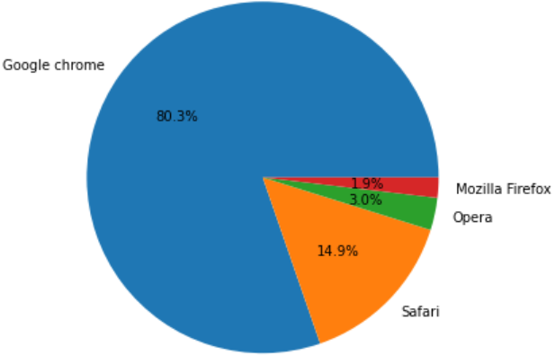
c
EDA and Visualizations
c) Operation system (OS) of the device used:
Almost half of the customers used Windows, almost 1/3rd of them used android while almost 1/4th of them use iOS/Mac
d) Browser used:
80% of customers use chrome browser and access the store from the website.
e) Channel followed for the first time:
85 % of them just use search engine and not a particular online store.
d

Slide 10
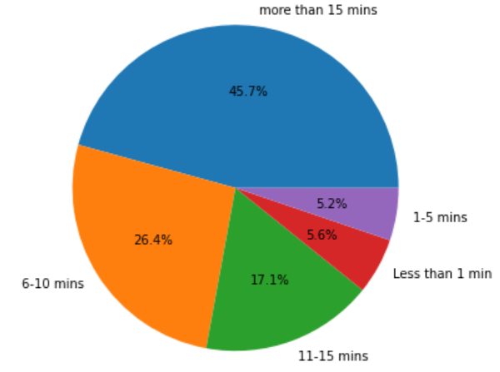
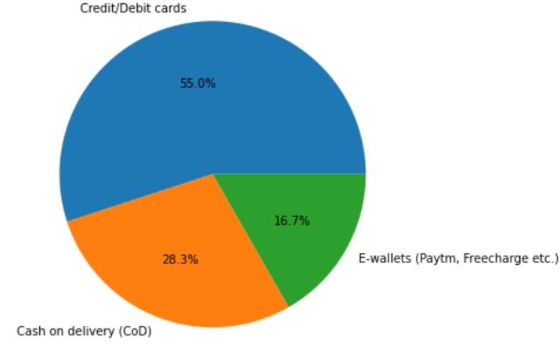
a
EDA and Visualizations
4. How customers react once they visit the store
Time of exploration before making any purchase:
Almost half of them use more than 15 mins
Around 1/10th of them use less than 5 mins.
b) Preferred payment option:
More than half of them prefer Credit/Debit card payments.
Around 1/4th of them prefer Cash on Delivery.
b

Slide 11
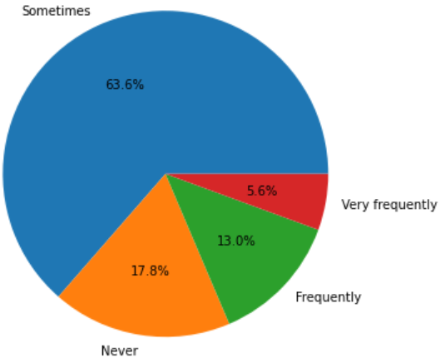
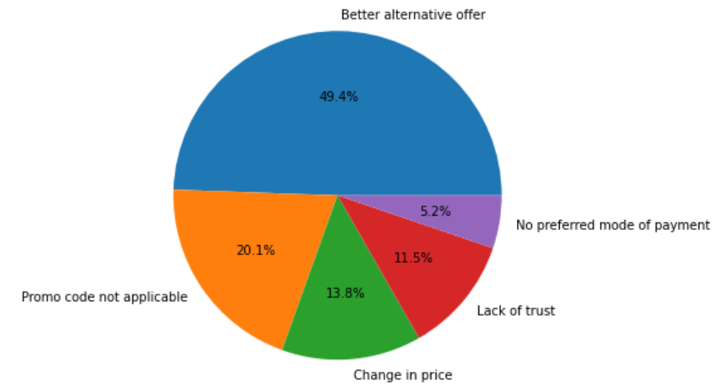
EDA and Visualizations
1
c) How frequently do you abandon (selecting items and leaving without making payment) your shopping cart?
Only 17 % of them never abandon their selection.
Half of the customers sometimes abandon it since they have a better alternative, or unavailability of promo code, change in price, lack of trust and no preferred payment options.
2

Slide 12
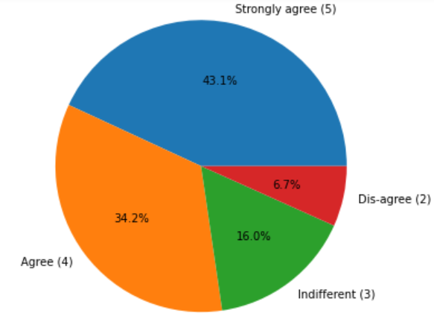
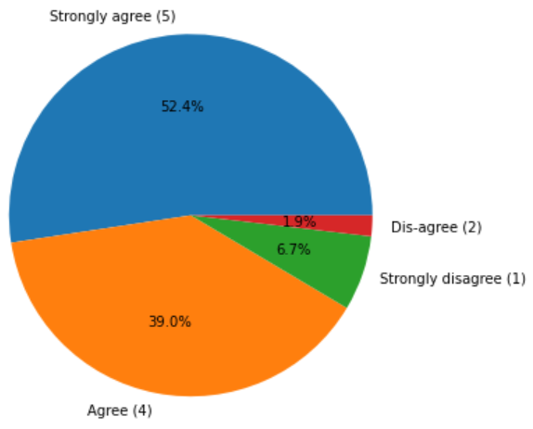
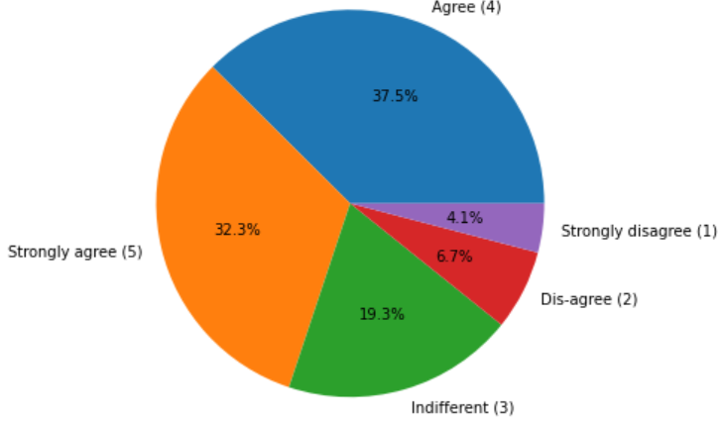
EDA and Visualizations
d) Quality and accessibility of content
Almost 80% of them agree that suggested items should be there for better comparison with other items, and 2/3rd of them agree that the contents should be easily understandable and should be user friendly.
Almost 80% of them agree that there should be complete info on seller and product details.
Around 90% agrees that easily accessible application attracts them and gives them satisfaction while shopping online.
1
2
3

Slide 13
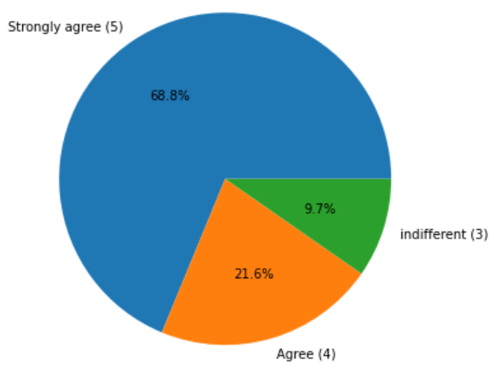
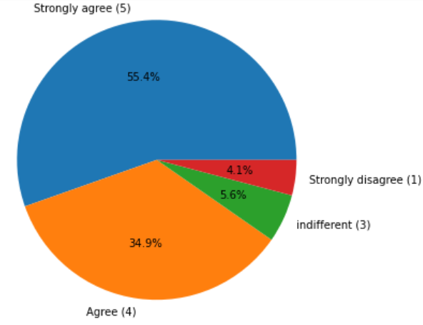
EDA and Visualizations
a
5. Service quality towards customers
a) Privacy:
Around 90% of them want to maintain their privacy.
b) Availability:
More than half of them agrees to a better responsiveness and availability of several communications like email, twitter, phone, etc.
b

Slide 14
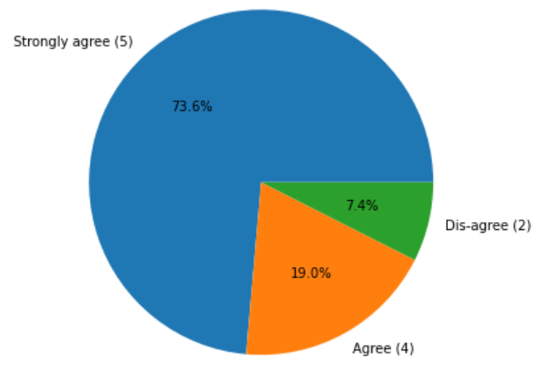
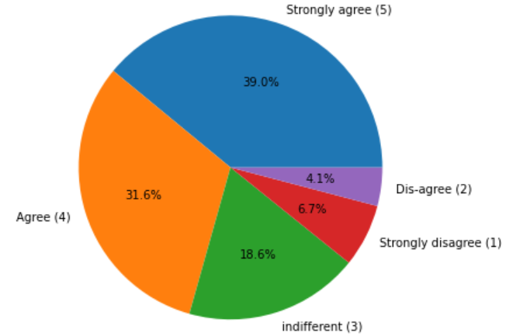
EDA and Visualizations
c
c) Return/replacement policy:
More than 90% of them expects proper return/replacement policy since customers cannot feel or touch the product they are purchasing.
6. Benefits of online shopping
a) Monetary benefits
More than 2/3rd of them agrees that online shopping gives monetary benefits and better discounts
a

Slide 15
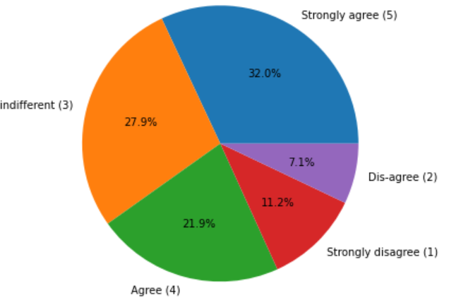
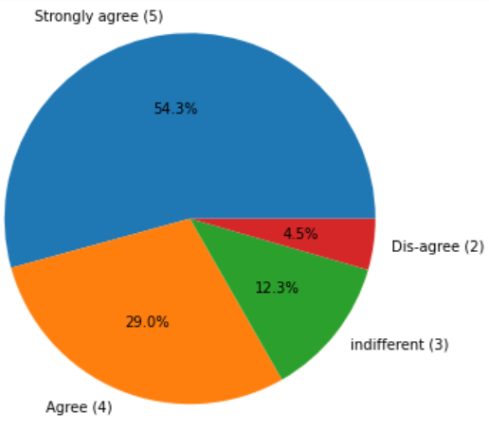
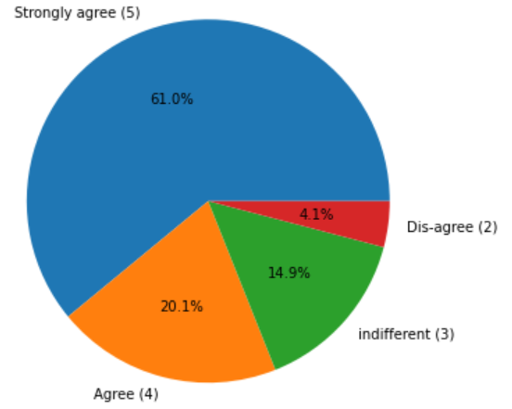
EDA and Visualizations
1
b) Emotional benefits
More than half of them agrees that they enjoyed online shopping.
More than 80% of them agrees that it is convenient and flexible since you can choose item easily and compare them with other products.
Around 80% of them agrees that net benefit from online shopping leads to their satisfaction.
2
3

Slide 16
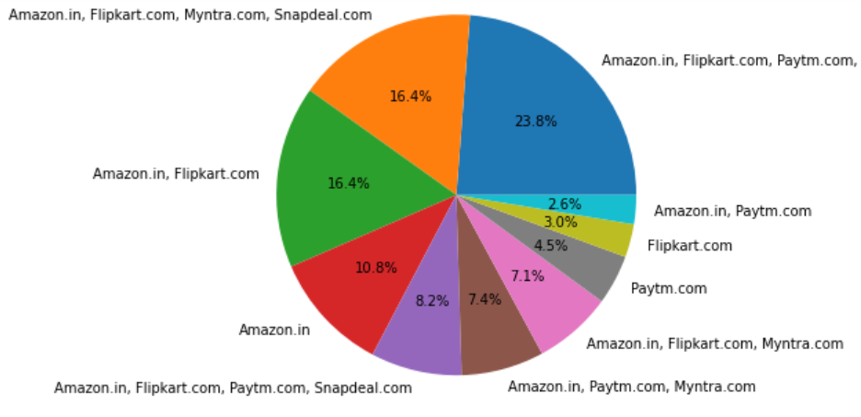
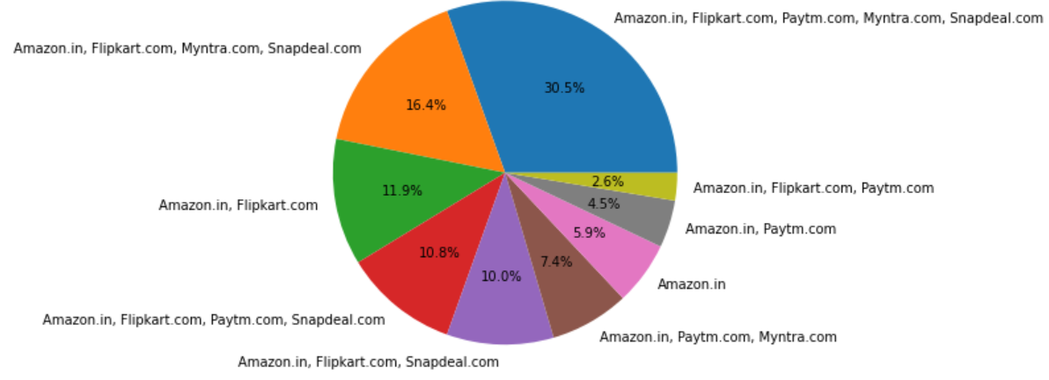
2
EDA and Visualizations
7. Influence of retailers on customers:
a) Popularity and accessibility:
Amazon gained the most popularity among all other retailers followed by Flipkart, Myntra and Snapdeal.
More than 90% of them find Amazon to be the easiest to use, most appealing, wild variety of product and detailed information on the product followed by Flipkart and Myntra.
1

Slide 17
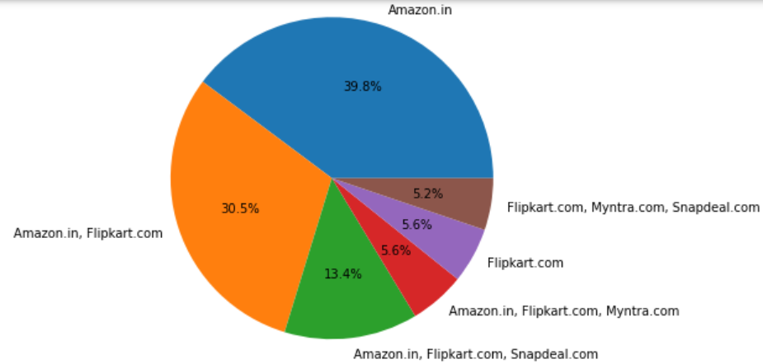
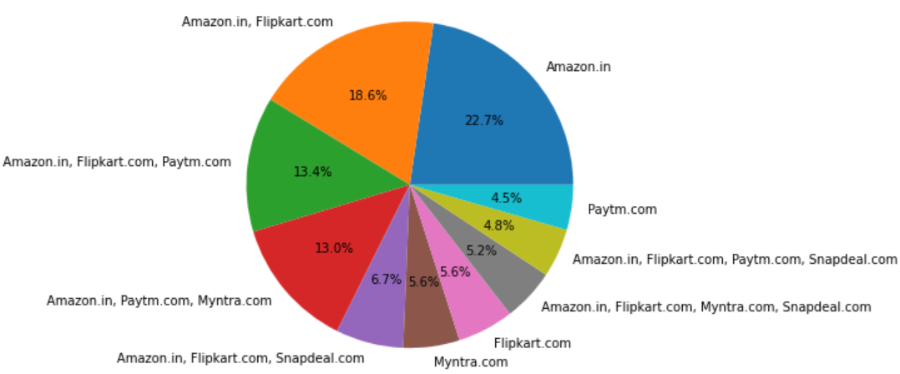
EDA and Visualizations
2
b) Reliability and delivery:
Most customers find Amazon to be the most reliable retailer followed by Flipkart, Myntra, Paytm and Snapdeal
Speed of delivery is the fastest for Amazon according to most customers.
1

Slide 18
Analysis
Personal Information
a) Age:
Most of the customers fall in the age group of 20 to 50 years.
We can see that this age group contributes more than 85% of the total customers.
So, should focus on the needs and interests of these age group more.
But need to keep in mind that company needs to attract kids and elder people if expansion of marketing is the goal while retaining the 20-50 age group people.
b) Gender:
Around 2/3rd of the customers are female customers which shows that women are more involved in online shopping.

Slide 19
Analysis
2. Customer activities while shopping online:
a) Duration of online shopping:
16% of the customers needs to be activated and motivated to continue shopping online since they have been using online shopping for less than a year. They need retention and activation.
b) Number of purchases made in the past year:
Only 2.2% of them have made online purchase of more than 42 times. Need more number of customers. Some discounts or promo code or maybe some extra credit could attract customers to make more number of purchases.
Almost half of the customers have made purchase less than 10 times only which needs to be handled and needs activation.

Slide 20
Analysis
3. How customers reach online shopping platforms
a) Device used:
Need to have a better UI, easy to access the items from the online shop for smartphones and laptop so that customers are attracted by the platform.
b) Screen size:
To retain customers, need a more compact but at the same time easy to access for even smaller screen size since only 1/3rd of them has a bigger screen sized laptop.
Or maybe if there could be a different UI for smartphone and PC so that according to the device they used, they can access the online items with comfort and ease.
c) Operation system (OS) of the device used:
The online app should be compatible and easily available and free for all OS.

Slide 21
Analysis
d) Channel followed for the first time:
For most customers, if their interested item popped up in the search engine, then it is likely that they would just click the first appearing store.
So, first time users may not know popular online store at first.
Need more attention on this and need better advertisements so that e-com company would attract first time users.
4. How customers react once they visit the store
a) Time of exploration before making any purchase:
Around 1/10th of them use less than 5 mins. This could mean that they did not find what they are looking for and not interested to hang around in the app.
Need more variety of items and even discounts attract people because they would try to find most discounted item

Slide 22
Analysis
b) Preferred payment option:
Need more security of payments and customer care in this regard especially if money is involved.
c) How frequently do you abandon (selecting items and leaving without making payment) your shopping cart?
Most customers sometimes abandon it since they have a better alternative, or unavailability of promo code, change in price, lack of trust and no preferred payment options.
4. Service quality towards customers
Return/replacement policy:
More than 90% of them expects proper return/replacement policy since customers cannot feel or touch the product they are purchasing.

Slide 23
Conclusion
Majority of the customers are in the age group of 20 to 50 years and they pay importance on how easy the app is to access and also the user friendliness plays an important role too.
The cost and offers available also plays important role since to attract more customers, e-com companies need to step up and compete against offline market and offer what offline market cannot offer. Speedy delivery is also an important factor.
The reason why most customers abandon their shopping cart is because they see better alternative, better offer from other platforms, and also because of the unavailability of their preferred payment option.
Customers also consider reliability of the retailer. Since all purchases are made online, customers feel that if they can’t touch or feel the product, they need assurance that the item they ordered reaches their expectation. And if not, they would like to return or replace and this return/replacement policy also plays an important role in choosing the retailer.
Of all the online e-commerce company, Amazon is the most trusted and most of the customers who are being surveyed would recommend Amazon to their friend, followed by Flipkart.

Slide 24
Thank You

